Slide 1

Word Embeddings
Lecturer: Shangsong Liang
Sun Yat-sen University
Notes:
Thanks to Christopher Manning

Slide 2
Lecture Plan
Word Embeddings
Finish looking at word vectors and word2vec
Optimization basics
Can we capture this essence more effectively by counting?
The GloVe model of word vectors
Evaluating word vectors
Word senses
The course
Goal: be able to read word embeddings papers by the end of class
2

Slide 3
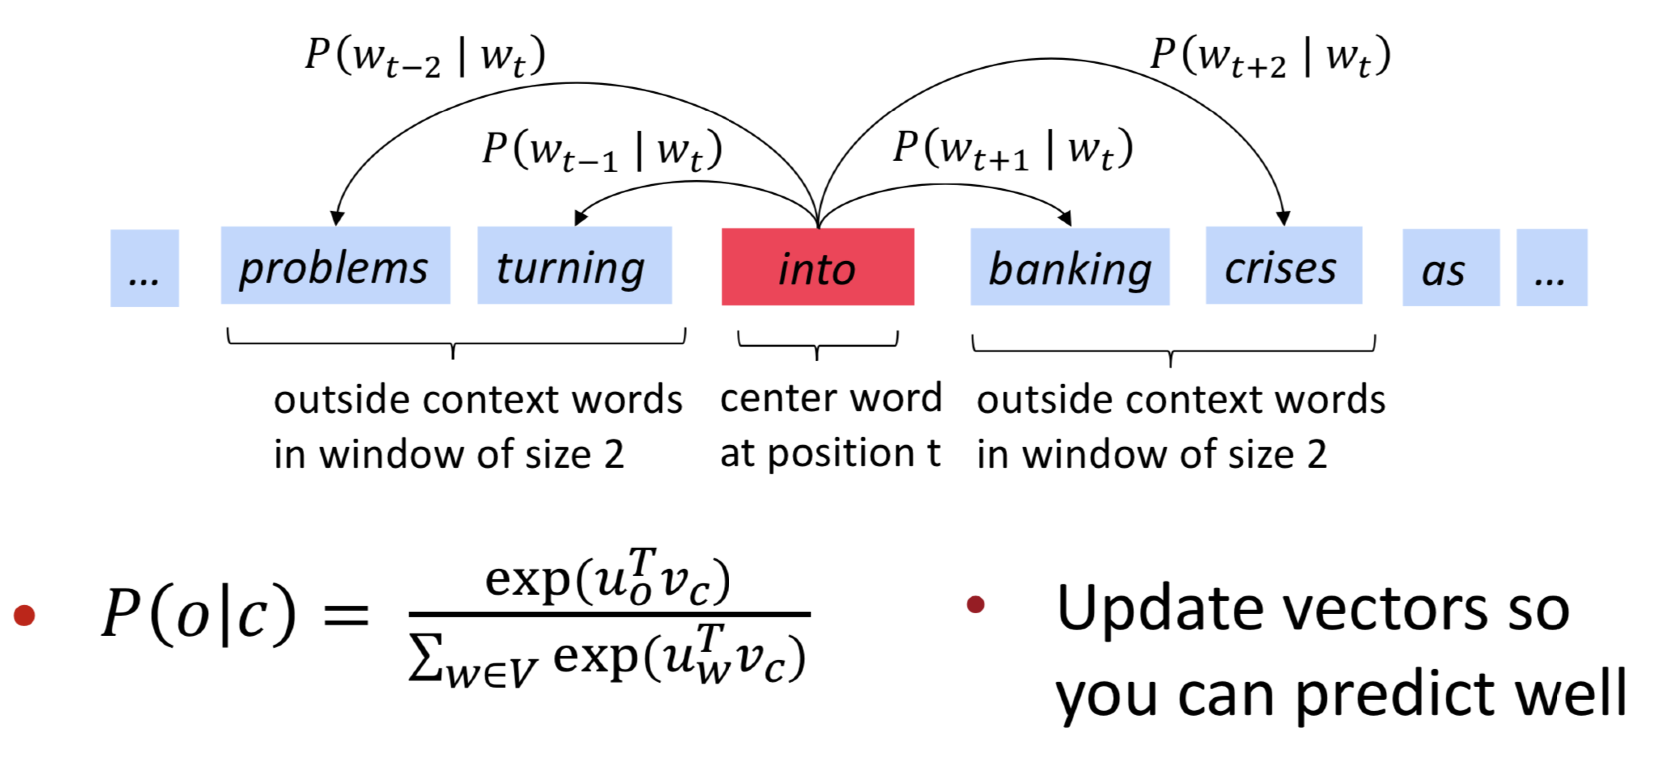
1. Review: Main idea of word2vec
Iterate through each word of the whole corpus
Predict surrounding words using word vectors
3

Slide 4
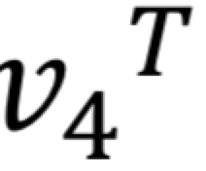
Word2vec parameters and computations
• • • • •
• • • ••
• • • ••
• • • ••
• • • ••
• • • ••
U
• • • • •
• • • ••
• • • ••
• • • ••
• • • ••
• • • ••
V
center
•
•
•
•
•
•
•
•
•
•
•
•
dot product
softmax(𝑈. ) probabilities
𝑈.
outside
Same predictions at each position
We want a model that gives a reasonably high probability estimate to all words that occur in the context (fairly often)

Slide 5
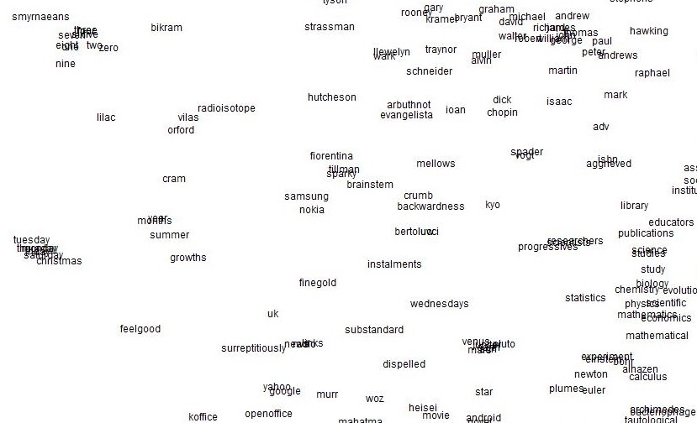
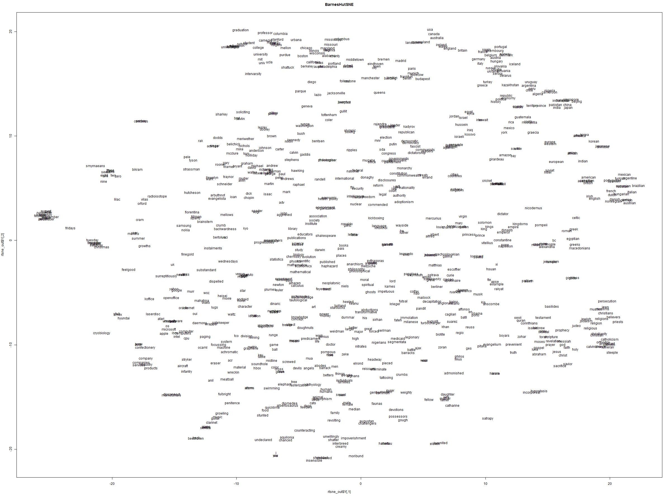
Word2vec maximizes objective function by putting similar words nearby in space

Slide 6

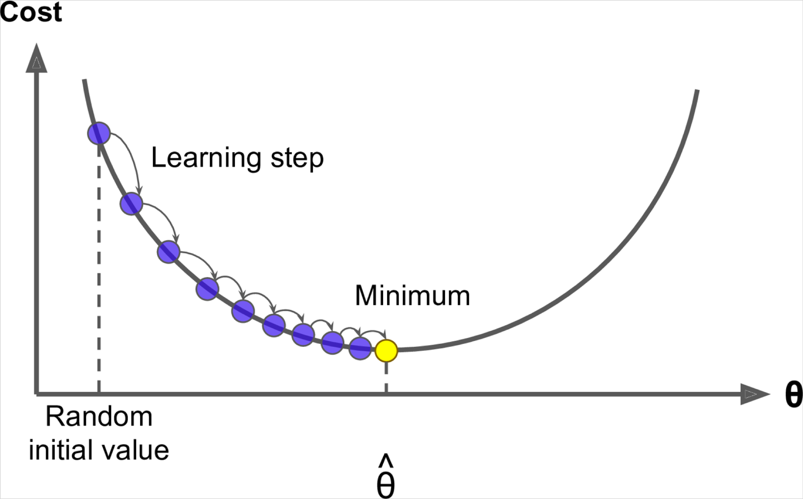
2. Optimization: Gradient Descent
We have a cost function 𝐽( )we want to minimize
Gradient Descent is an algorithm to minimize 𝐽( )
Idea: for current value of , calculate gradient of 𝐽( ), then take small step in the direction of negative gradient. Repeat.
Note: Our objectives may not be convex like this

Slide 7
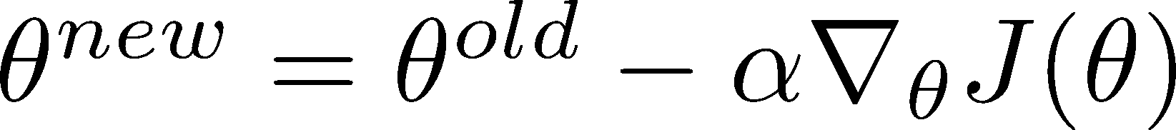
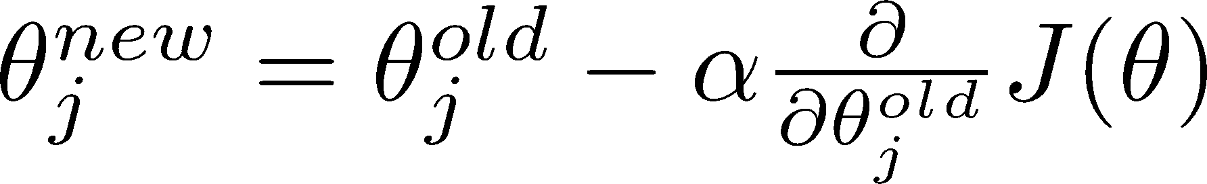
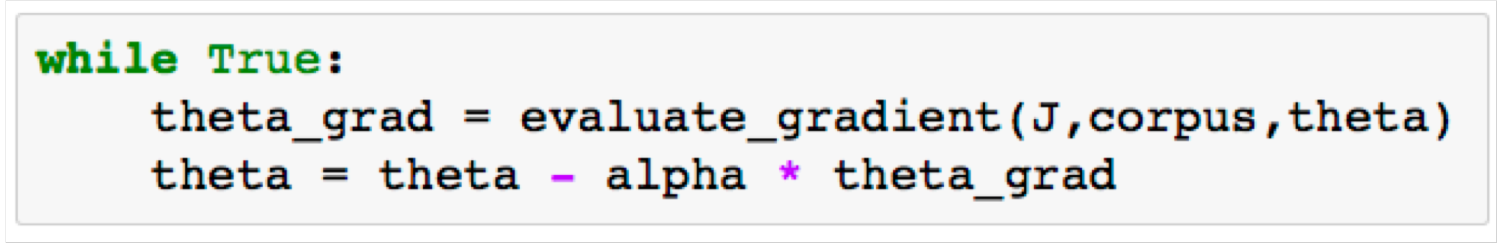
Gradient Descent
Update equation (in matrix notation):
𝛼 = step size or learning rate
Update equation (for a single parameter):
Algorithm:

Slide 8

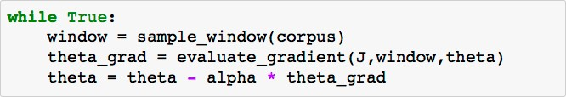
Stochastic Gradient Descent
Problem: 𝐽( ) is a function of all windows in the corpus (potentially billions!)
  So is very expensive to compute
You would wait a very long time before making a single update!
Very bad idea for pretty much all neural nets!
Solution: Stochastic gradient descent (SGD)
  Repeatedly sample windows, and update after each one
Algorithm:

Slide 9

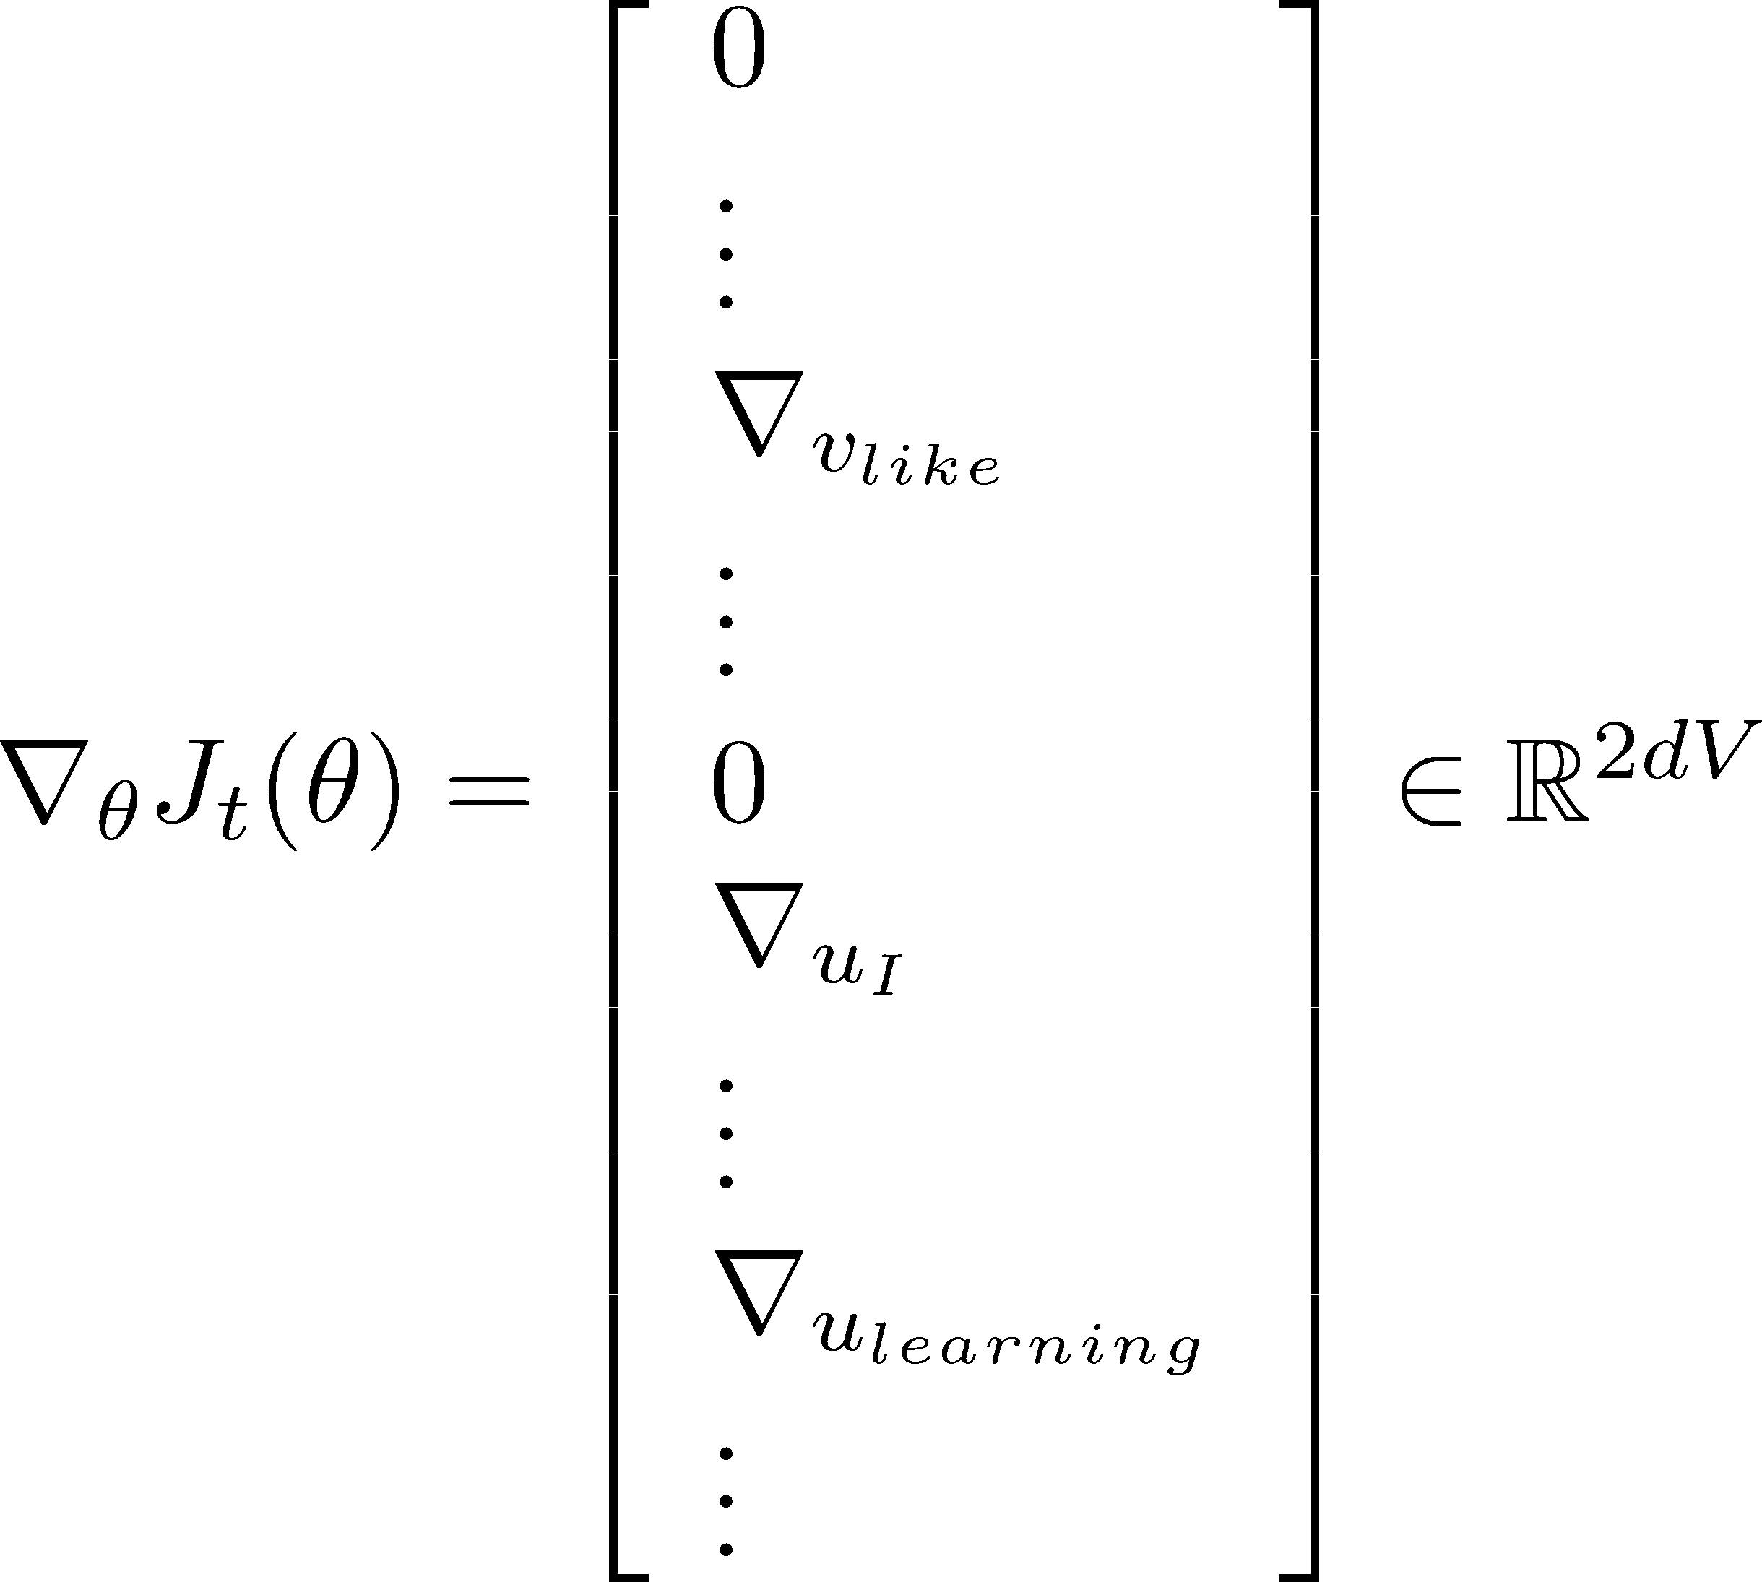
Stochastic gradients with word vectors!
Iteratively take gradients at each such window for SGD
But in each window, we only have at most 2m + 1 words, so is very sparse!

Slide 10




Stochastic gradients with word vectors!
We might only update the word vectors that actually appear!
Solution: either you need sparse matrix update operations to only update certain rows of full embedding matrices U and V, or you need to keep around a hash for word vectors
[ ]
d
|V|
If you have millions of word vectors and do distributed computing, it is important to not have to send gigantic updates around!

Slide 11
1b. Word2vec: More details
Why two vectors? → Easier optimization. Average both at the end
But can do it with just one vector per word Two model variants:
Skip-grams (SG)
Predict context (“outside”) words (position independent) given center word
Continuous Bag of Words (CBOW)
Predict center word from (bag of) context words We presented: Skip-gram model
Additional efficiency in training:
1. Negative sampling
So far: Focus on naïve softmax (simpler, but expensive, training method)

Slide 12
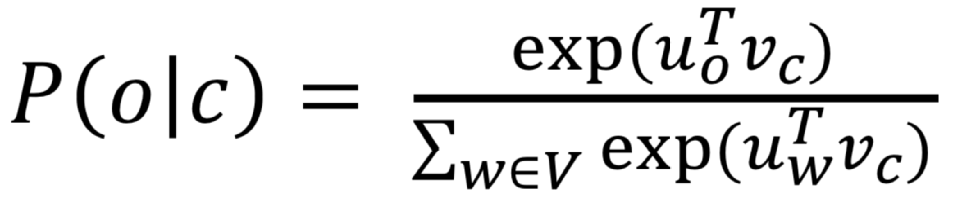
The skip-gram model with negative sampling
The normalization factor is too computationally expensive.
。
Hence, in standard word2vec you implement the skip-gram model with negative sampling
Main idea: train binary logistic regressions for a true pair (center word and word in its context window) versus several noise pairs (the center word paired with a random word)

Slide 13
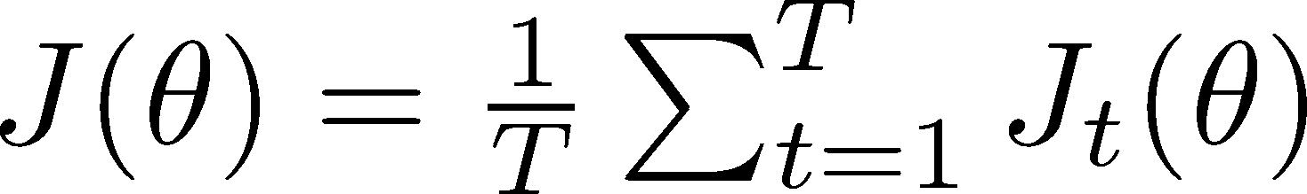
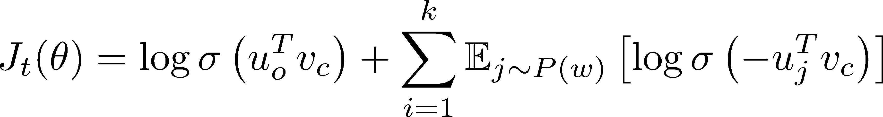
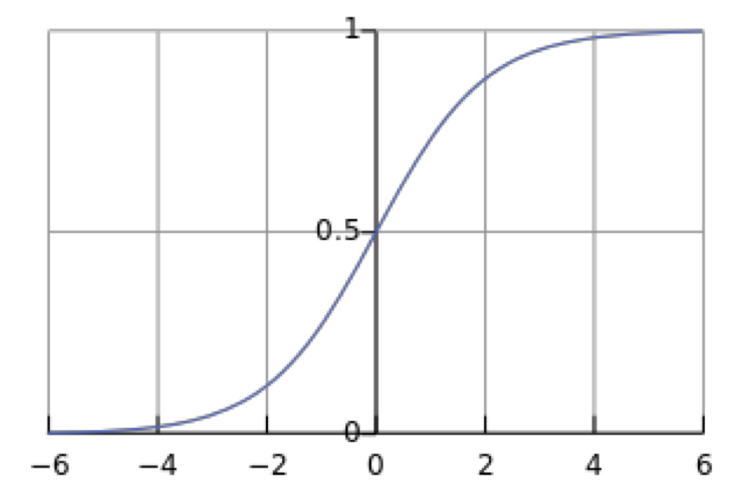
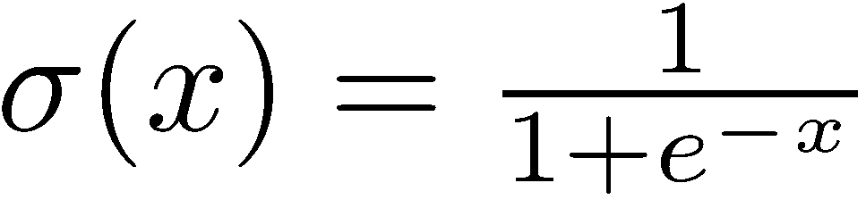
The skip-gram model with negative sampling
From paper: “Distributed Representations of Words and Phrases and their Compositionality” (Mikolov et al. 2013)
Overall objective function (they maximize):
The sigmoid function:
(we’ll become good friends soon)
So we maximize the probability
of two words co-occurring in first log
→
13

Slide 14
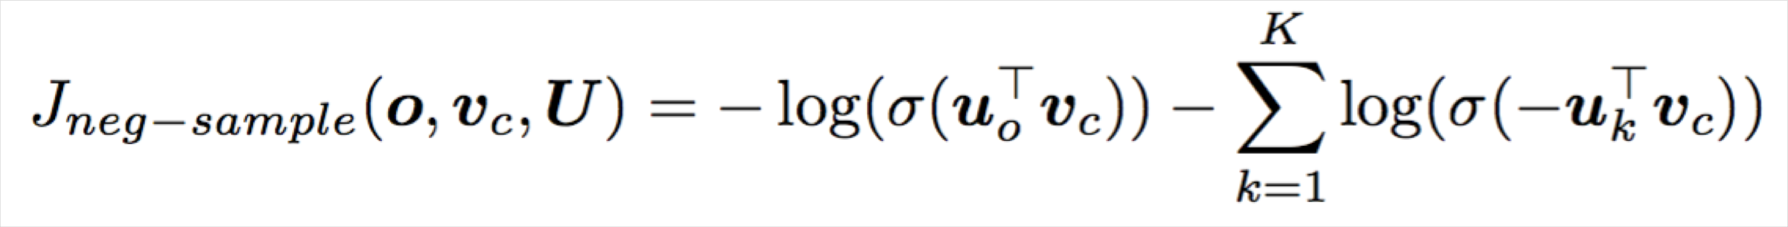
The skip-gram model with negative sampling
Notation more similar:
We take k negative samples (using word probabilities)
Maximize probability that real outside word appears,
minimize prob. that random words appear around center word
P(w)=U(w)^{3/4}/Z,
the unigram distribution U(w) raised to the 3/4 power (We provide this function in the starter code).
The power makes less frequent words be sampled more often
14

Slide 15
3. But why not capture co-occurrence counts directly?
With a co-occurrence matrix X
2 options: windows vs. full document
Window: Similar to word2vec, use window around each word → captures both syntactic (POS) and semantic information
Word-document co-occurrence matrix will give general topics (all sports terms will have similar entries) leading to “Latent Semantic Analysis”
15

Slide 16
Example: Window based co-occurrence matrix
Window length 1 (more common: 5–10)
Symmetric (irrelevant whether left or right context)
Example corpus:
  I like deep learning.
  I like NLP.
  I enjoy flying.
16

Slide 17
Window based co-occurrence matrix
Example corpus:
  I like deep learning.
  I like NLP.
  I enjoy flying.
counts | I | like | enjoy | deep | learning | NLP | flying | .
I | 0 | 2 | 1 | 0 | 0 | 0 | 0 | 0
like | 2 | 0 | 0 | 1 | 0 | 1 | 0 | 0
enjoy | 1 | 0 | 0 | 0 | 0 | 0 | 1 | 0
deep | 0 | 1 | 0 | 0 | 1 | 0 | 0 | 0
learning | 0 | 0 | 0 | 1 | 0 | 0 | 0 | 1
NLP | 0 | 1 | 0 | 0 | 0 | 0 | 0 | 1
flying | 0 | 0 | 1 | 0 | 0 | 0 | 0 | 1
. | 0 | 0 | 0 | 0 | 1 | 1 | 1 | 0
17

Slide 18
Problems with simple co-occurrence vectors
Increase in size with vocabulary
Very high dimensional: requires a lot of storage Subsequent classification models have sparsity issues
→ Models are less robust
18

Slide 19
Solution: Low dimensional vectors
Idea: store “most” of the important information in a fixed, small number of dimensions: a dense vector
Usually 25–1000 dimensions, similar to word2vec
How to reduce the dimensionality?
19

Slide 20
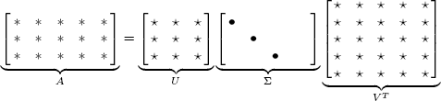

Method 1: Dimensionality Reduction on X
Singular Value Decomposition of co-occurrence matrix X
Factorizes X into UΣV^{T}, where U and V are orthonormal
_{X} k
Retain only k singular values, in order to generalize.
X! is the best rank k approximation to X , in terms of least squares. Classic linear algebra result. Expensive to compute for large matrices.
20

Slide 21
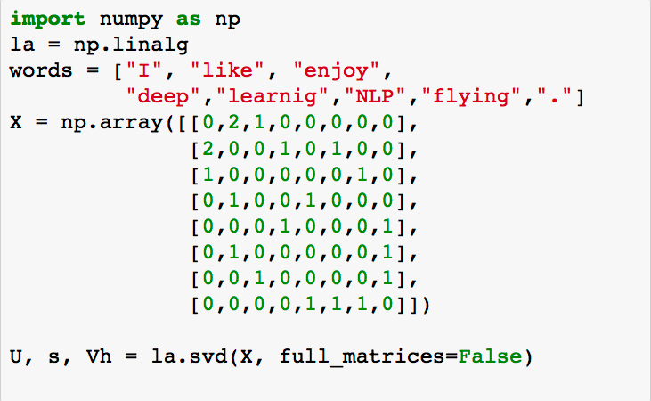
Simple SVD word vectors in Python
Corpus:
I like deep learning. I like NLP. I enjoy flying.
21

Slide 22
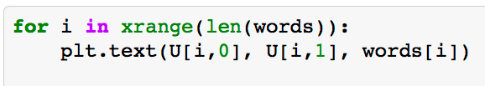
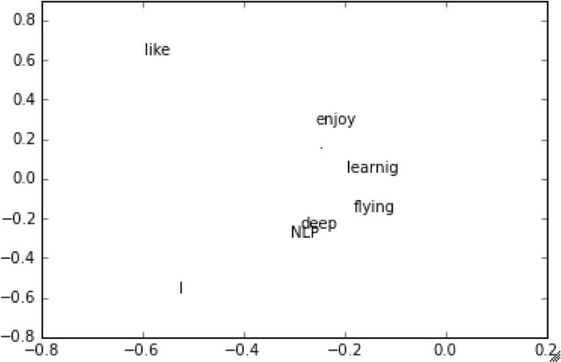
Simple SVD word vectors in Python
Corpus: I like deep learning. I like NLP. I enjoy flying.
Printing first two columns of U corresponding to the 2 biggest singular values
22

Slide 23
Hacks to X (several used in Rohde et al. 2005)
Scaling the counts in the cells can help a lot
Problem: function words (the, he, has) are too frequent → syntax has too much impact. Some fixes:
  min(X,t), with t ≈ 100
  Ignore them all
Ramped windows that count closer words more
Use Pearson correlations instead of counts, then set negative values to 0
Etc.
23

Slide 24
Interesting syntactic patterns emerge in the vectors
CHOOSING
CHOOSE CHOSCEHNOSE
STOLEN STEAL
STOLE
STEALING
SPOKE
SPEAK
TAKE
SPOKEN
TAKEN
SPEAKING
TAKING TOOK
THROW^{T}N^{HR}T^{O}H^{W}REW
THROWING
SHOWN
SHOWED SHOWING
EATENT
ATE
EATING
SHOW
GROWN
GROW
GREW
GROWING
COALS model from
An Improved Model of Semantic Similarity Based on Lexical Co-Occurrence Rohde et al. ms., 2005
24

Slide 25
Interesting semantic patterns emerge in the vectors
DRIVER
JANITOR STUDENT
DRIVE
SWIMMER
CLEAN
TEACHER
DOCTOR
BRIDE
SWIM
PRIEST
LEARN
TEACH
MARRY
TREAT
PRAY
COALS model from
An Improved Model of Semantic Similarity Based on Lexical Co-Occurrence Rohde et al. ms., 2005
25

Slide 26


Count based vs. direct prediction
LSA, HAL (Lund & Burgess),
COALS, Hellinger-PCA (Rohde et al, Lebret & Collobert)
Fast training
Efficient usage of statistics
Primarily used to capture word similarity
Disproportionate importance given to large counts
Skip-gram/CBOW (Mikolov et al)
NNLM, HLBL, RNN (Bengio et
al; Collobert & Weston; Huang et al; Mnih & Hinton)
Scales with corpus size
Inefficient usage of statistics
Generate improved performance on other tasks
Can capture complex patterns beyond word similarity
26

Slide 27
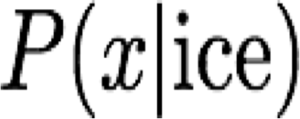
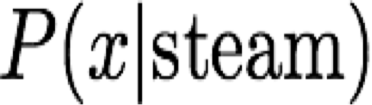
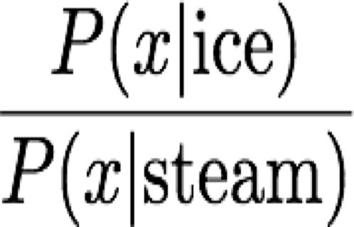
Encoding meaning in vector differences
[Pennington, Socher, and Manning, EMNLP 2014]
Crucial insight:
Ratios of co-occurrence probabilities can encode meaning components
 |  | x = solid | x = gas | x = water | x = random
 |  | large | small | large | small
 |  | small | large | large | small
 |  | large | small | ~1 | ~1

Slide 28
Encoding meaning in vector differences
[Pennington, Socher, and Manning, EMNLP 2014]
Crucial insight:
Ratios of co-occurrence probabilities can encode meaning components
 |  | x = solid | x = gas | x = water | x = fashion
 |  | 1.9 x 10⁻⁴ | 6.6 x 10⁻⁵ | 3.0 x 10⁻³ | 1.7 x 10⁻⁵
 |  | 2.2 x 10⁻⁵ | 7.8 x 10⁻⁴ | 2.2 x 10⁻³ | 1.8 x 10⁻⁵
 |  | 8.9 | 8.5 x 10⁻² | 1.36 | 0.96

Slide 29
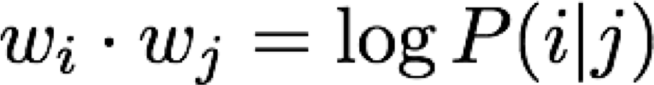
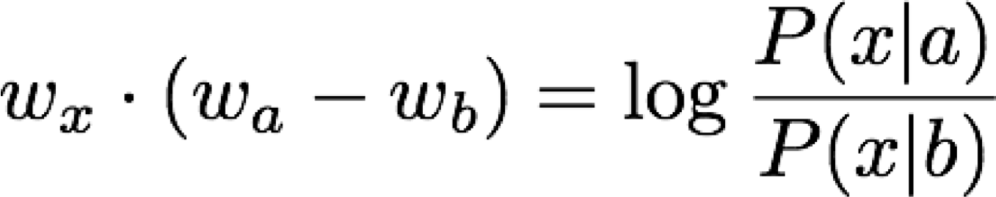
Encoding meaning in vector differences
Q: How can we capture ratios of co-occurrence probabilities as linear meaning components in a word vector space?
A: Log-bilinear model:
with vector differences

Slide 30
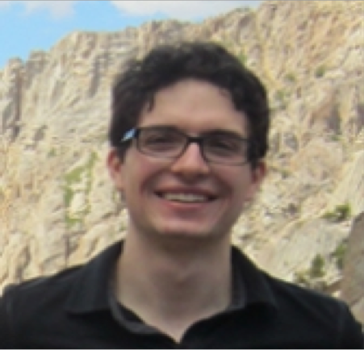
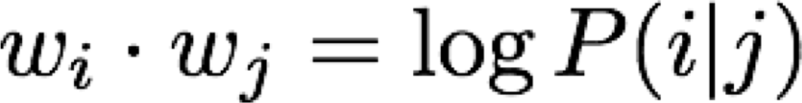
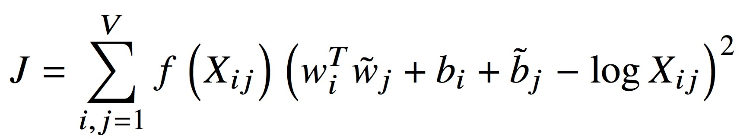
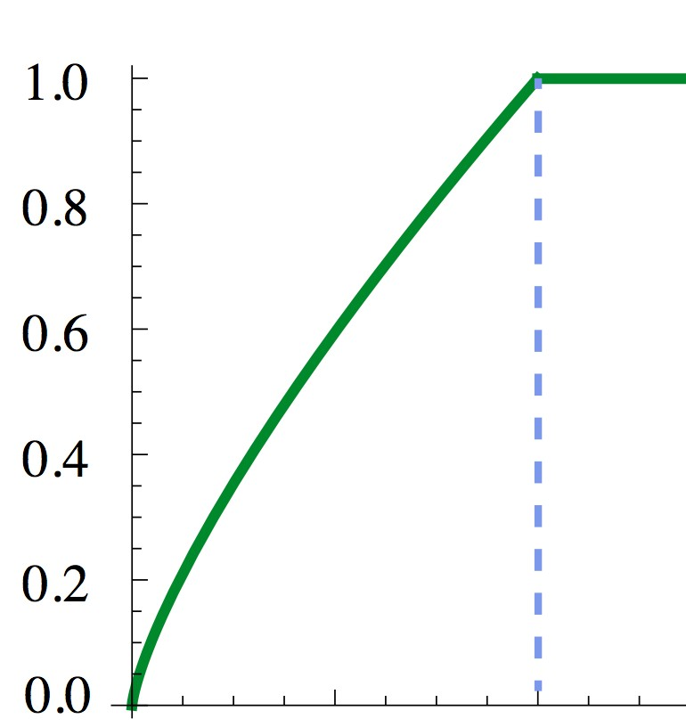
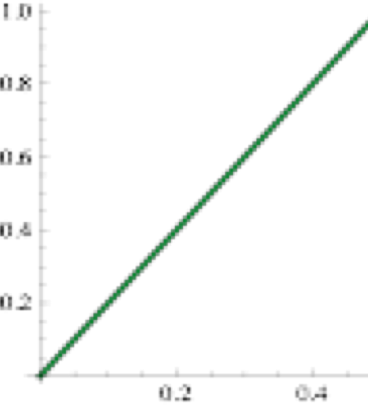

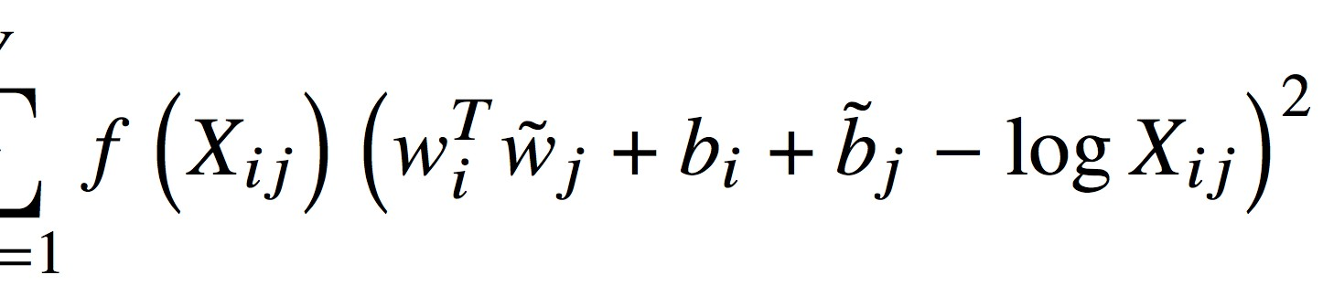
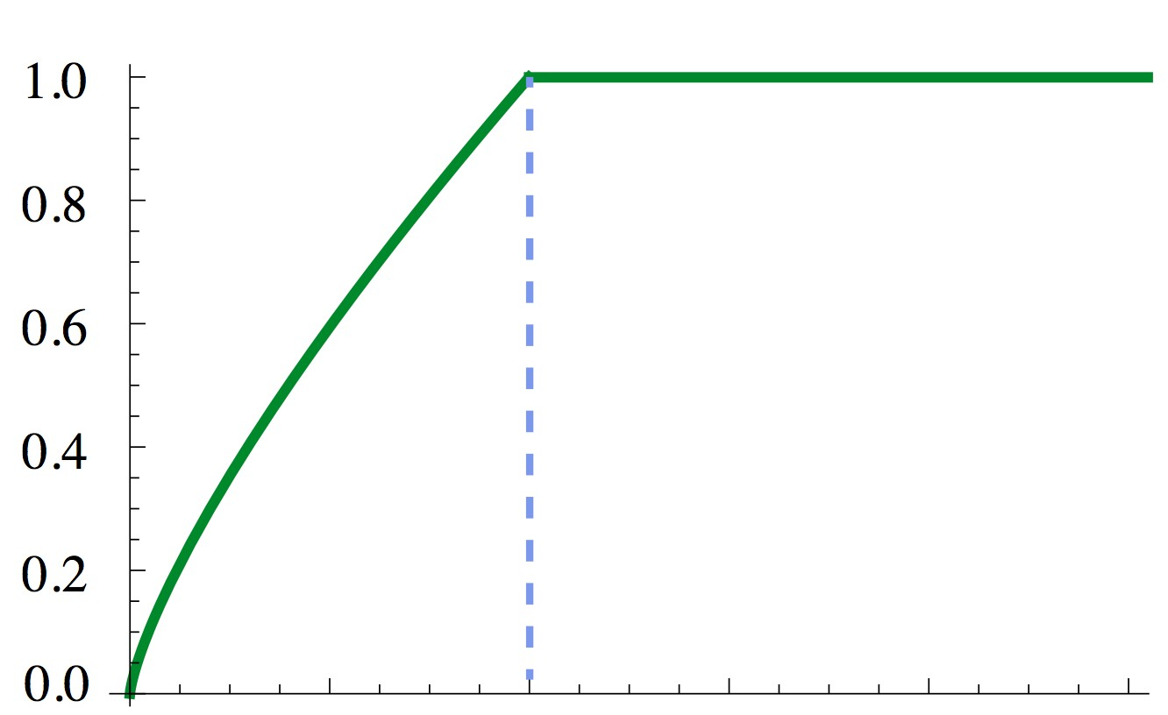
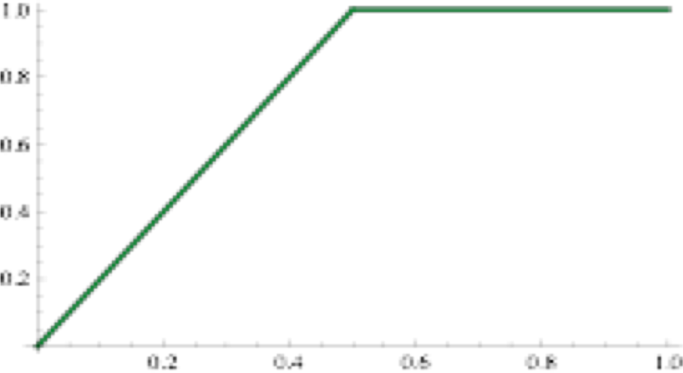

Combining the best of both worlds GloVe [Pennington et al., EMNLP 2014]
Fast training
Scalable to huge corpora
Good performance even with small corpus and small vectors

Slide 31
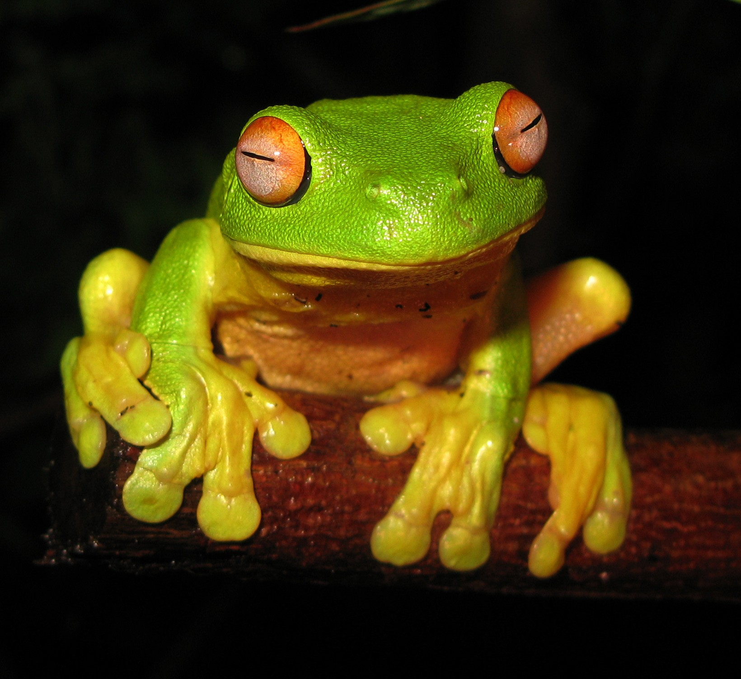
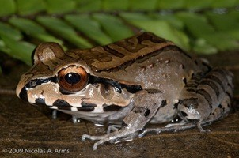
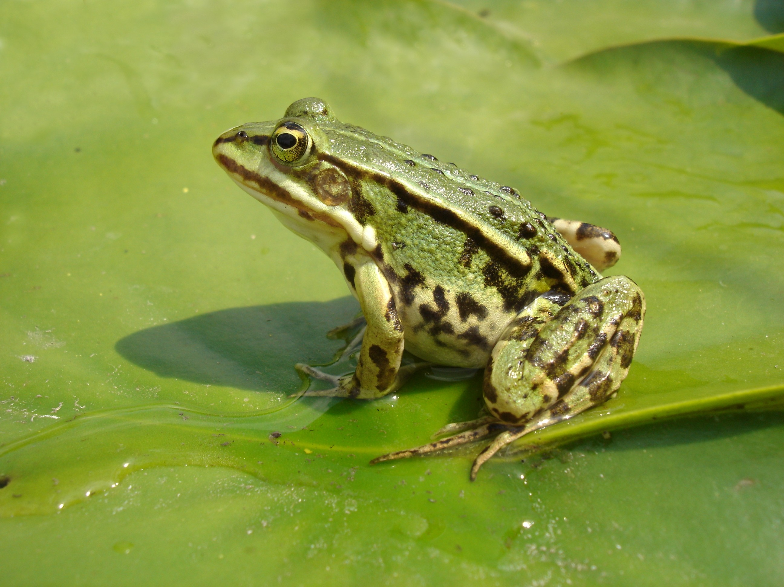
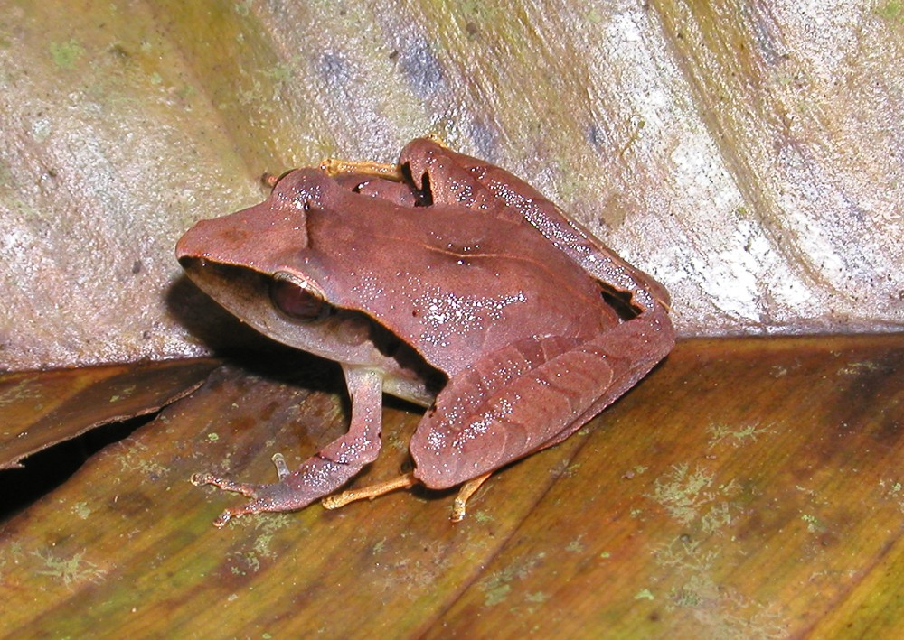
GloVe results
Nearest words to frog:
frogs
toad
litoria
leptodactylidae
rana
lizard
eleutherodactylus
litoria
leptodactylidae
rana
eleutherodactylus
31

Slide 32
How to evaluate word vectors?
Related to general evaluation in NLP: Intrinsic vs extrinsic
Intrinsic:
  Evaluation on a specific/intermediate subtask
  Fast to compute
  Helps to understand that system
  Not clear if really helpful unless correlation to real task is established
Extrinsic:
  Evaluation on a real task
  Can take a long time to compute accuracy
  Unclear if the subsystem is the problem or its interaction or other subsystems
  If replacing exactly one subsystem with another improves accuracy →
Winning!

Slide 33
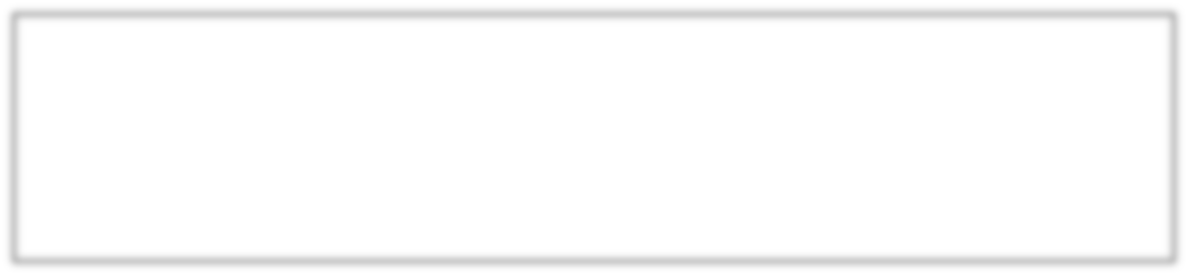

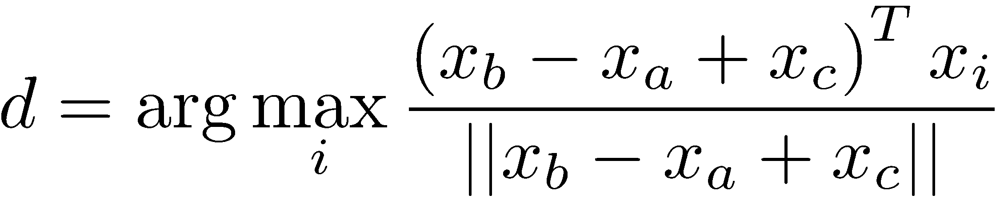

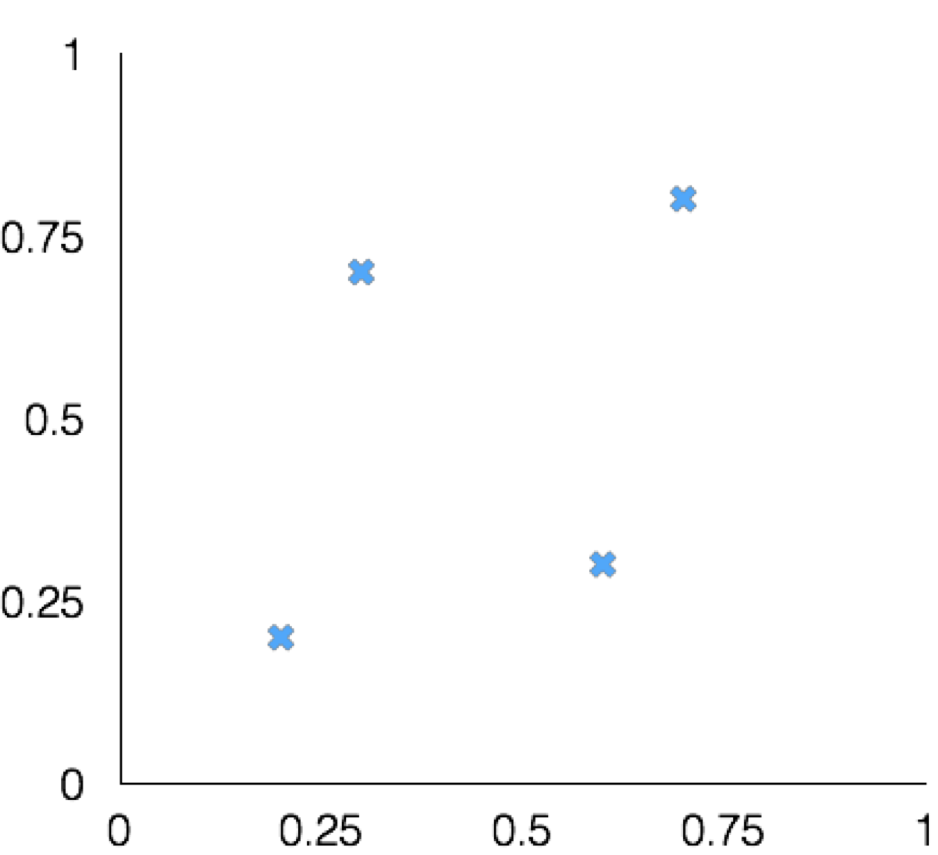
Intrinsic word vector evaluation
Word Vector Analogies
a:b :: c:?
man:woman :: king:?
Evaluate word vectors by how well their cosine distance after addition captures intuitive semantic and syntactic analogy questions
Discarding the input words from the search!
Problem: What if the information is there but not linear?
king
woman
man

Slide 34
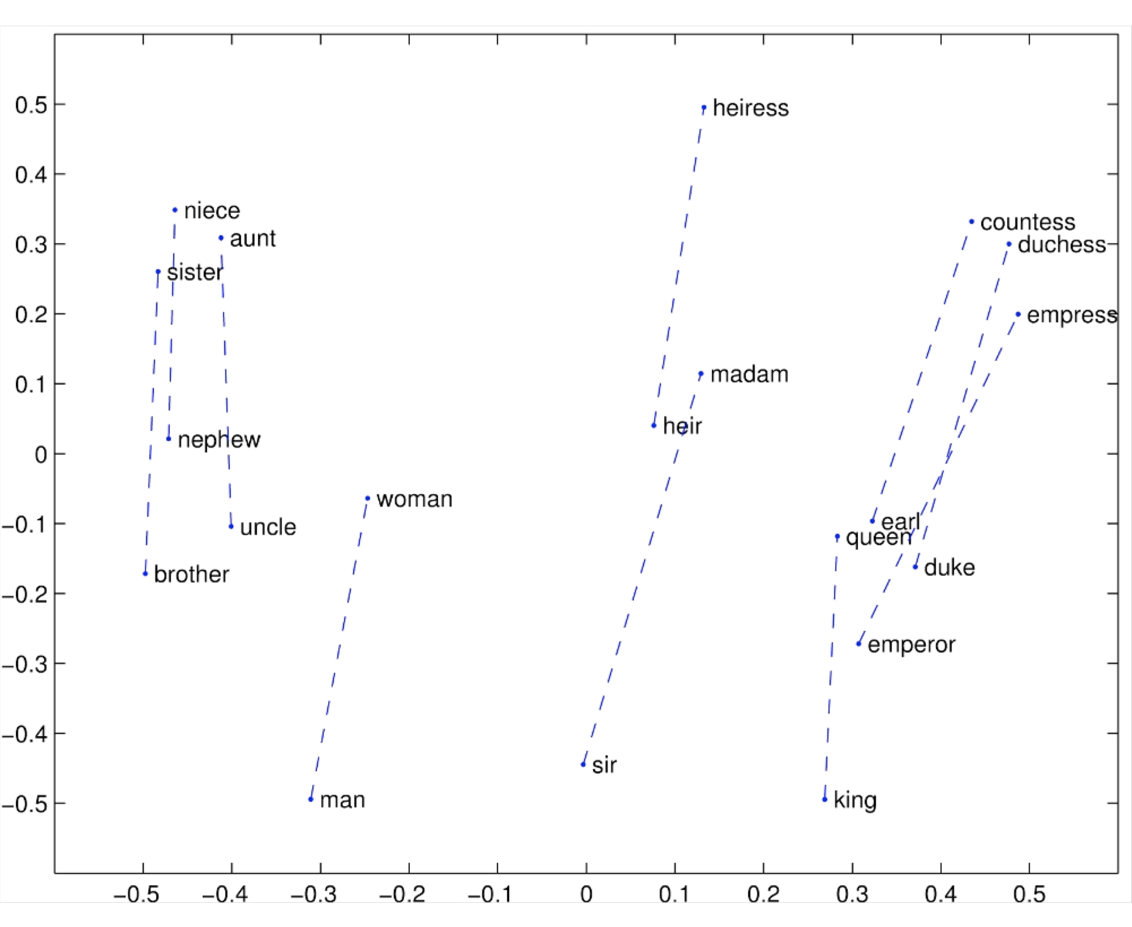
Glove Visualizations
34

Slide 35
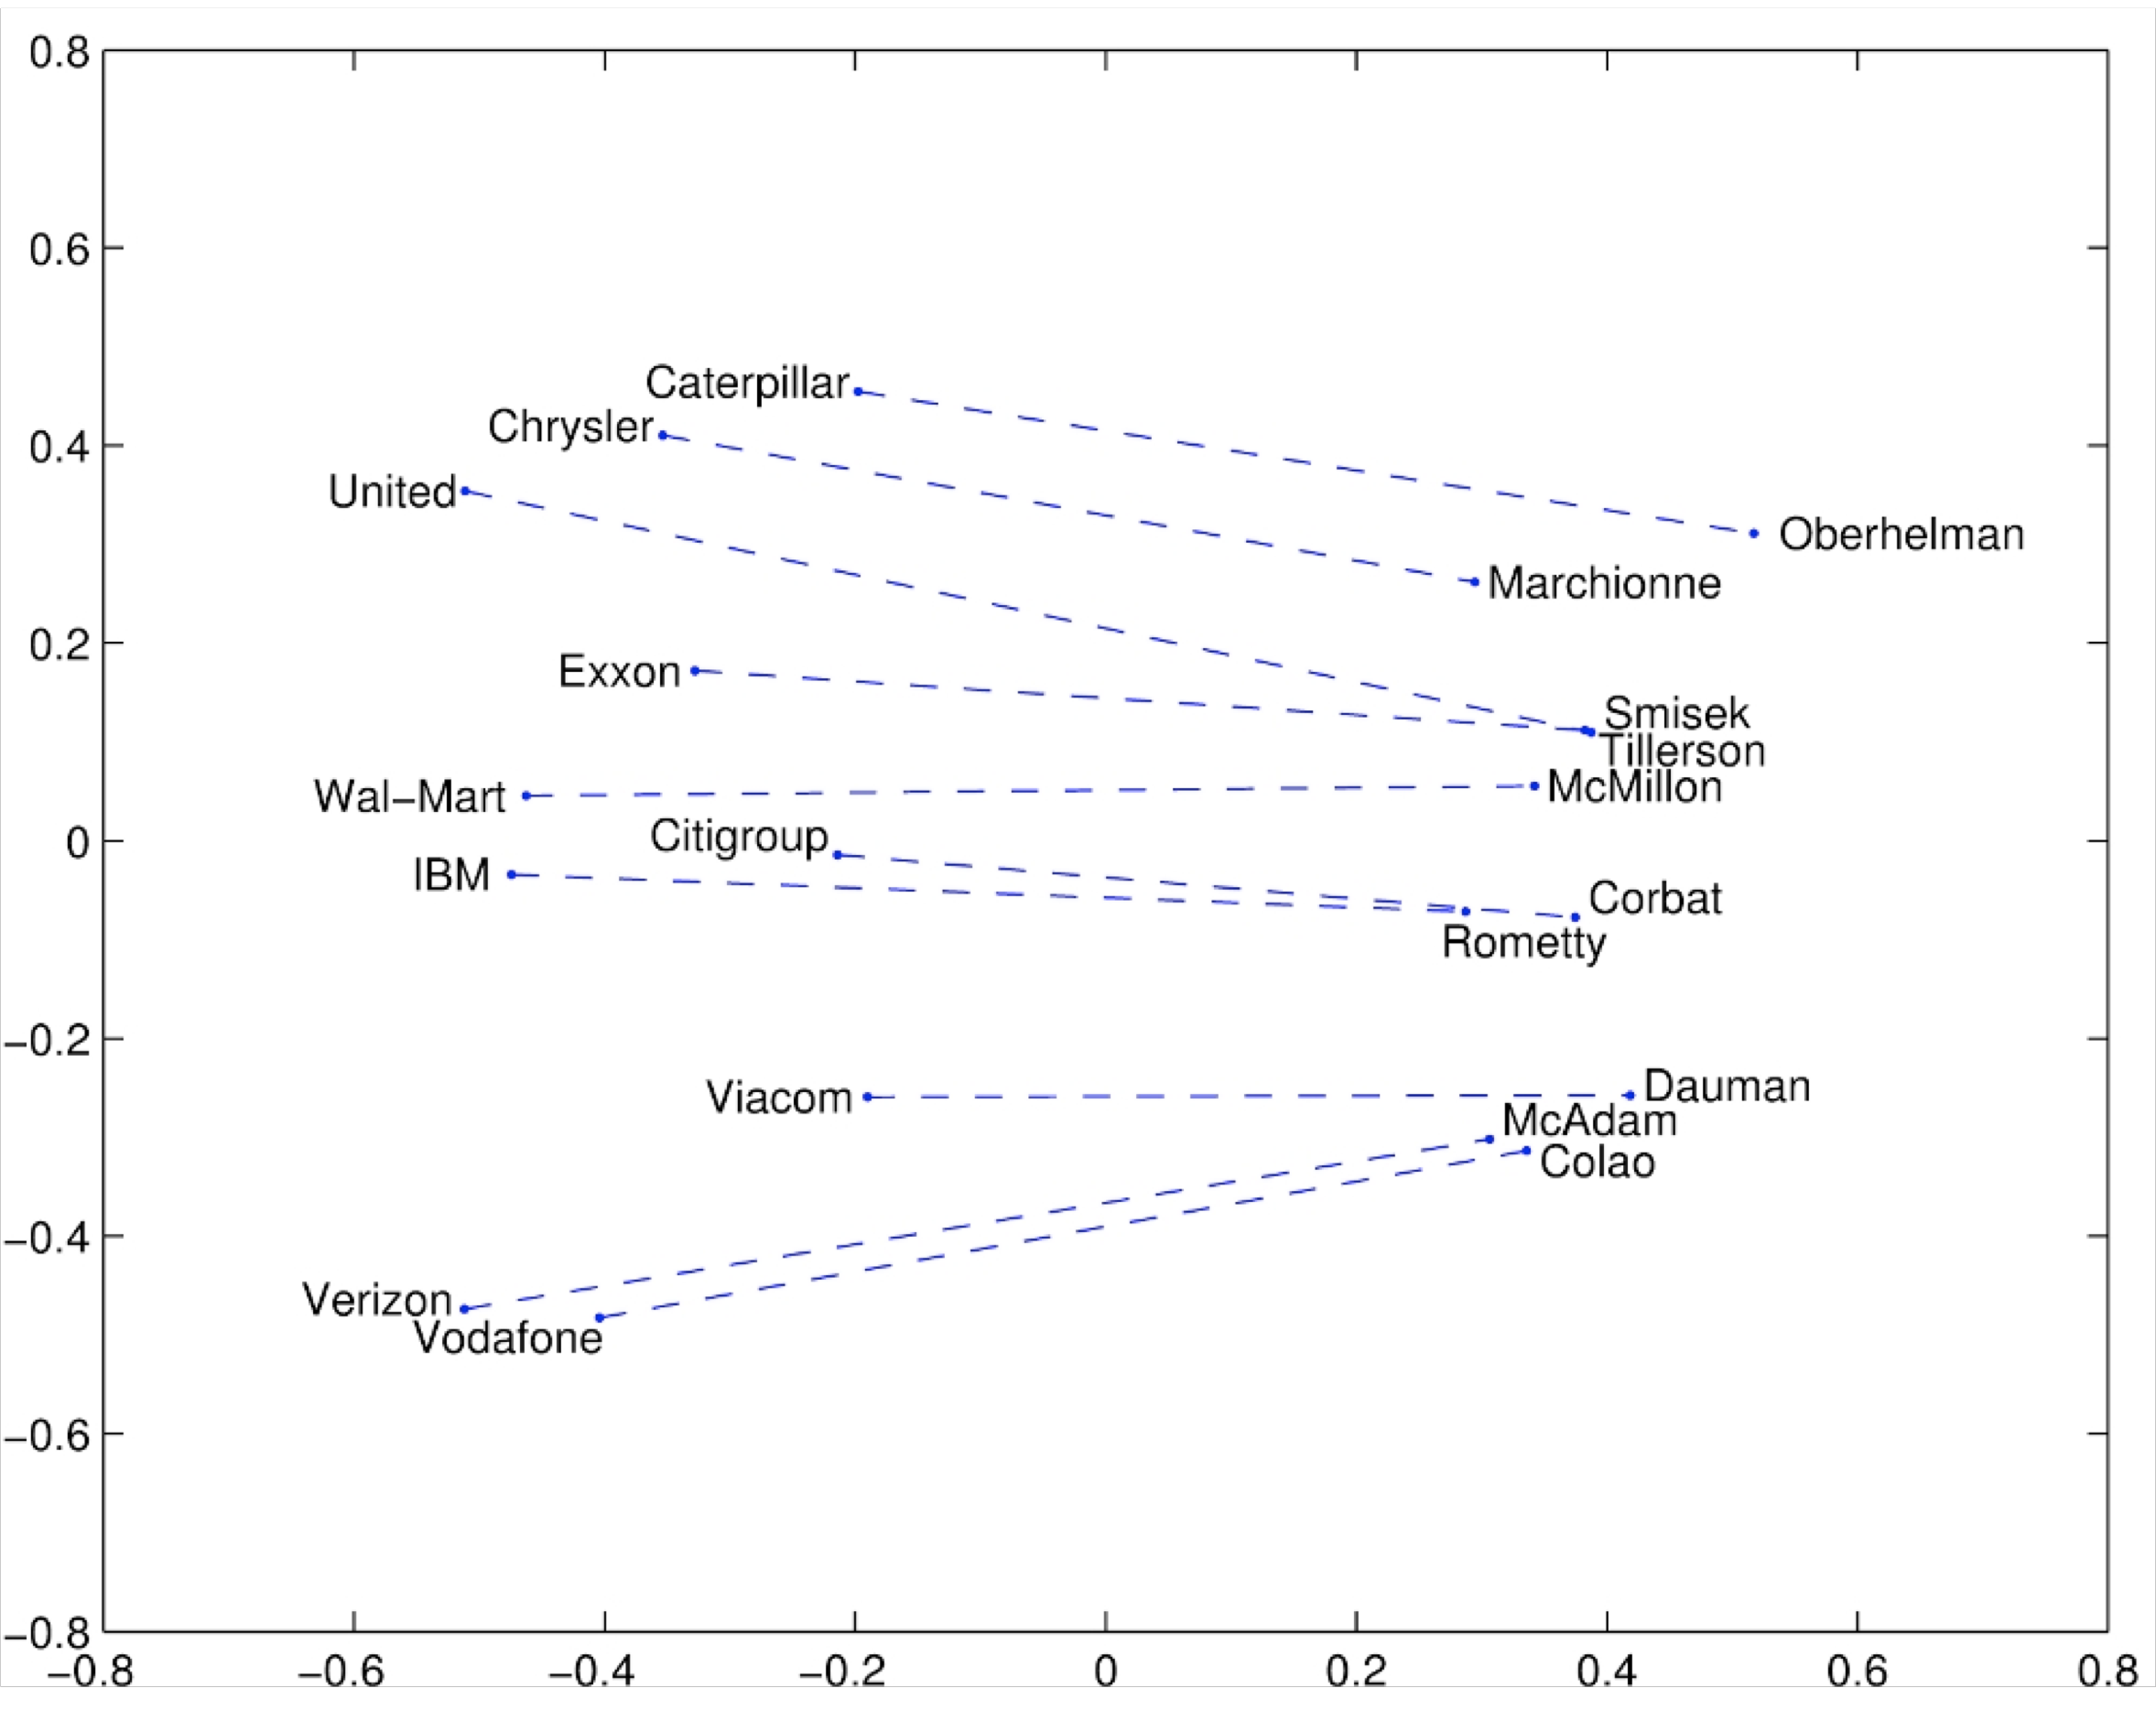
Glove Visualizations: Company - CEO
35

Slide 36
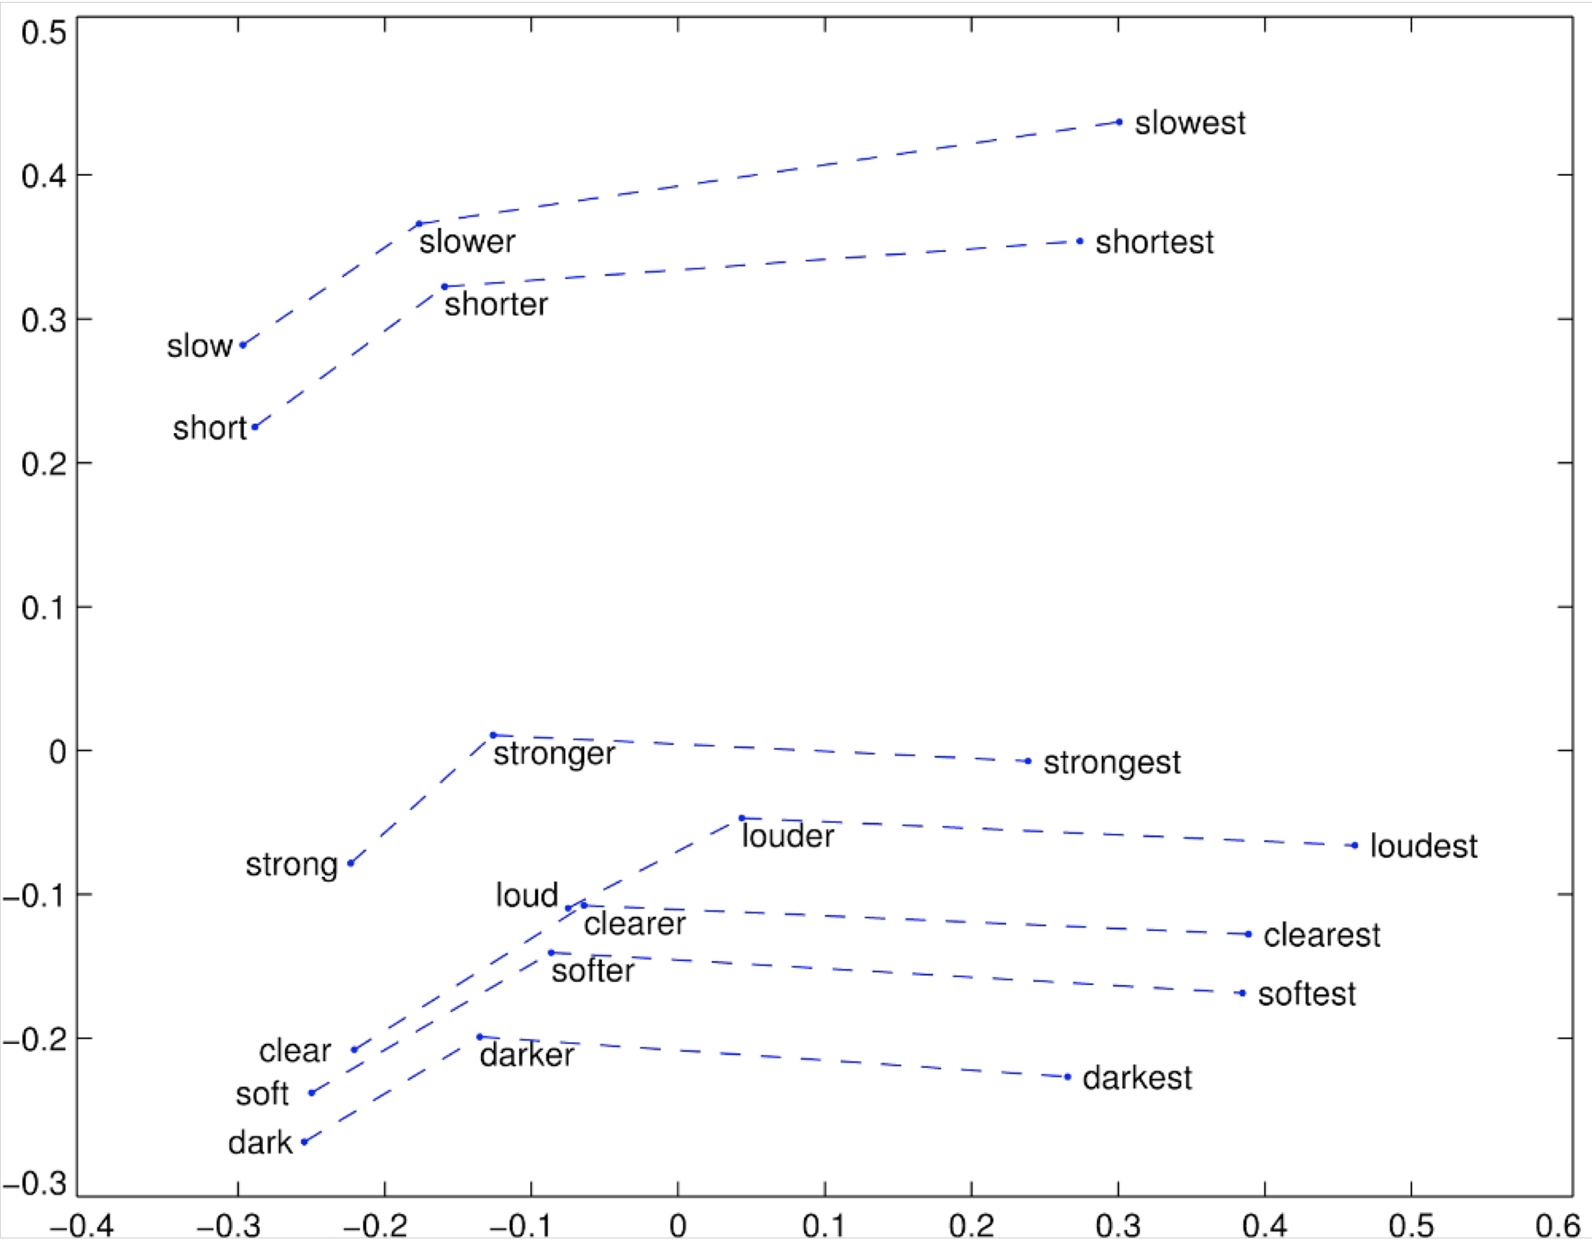
Glove Visualizations: Superlatives
36

Slide 37
Details of intrinsic word vector evaluation
Word Vector Analogies: Syntactic and Semantic examples from http://code.google.com/p/word2vec/source/browse/trunk/questions- words.txt
: city-in-state
Chicago Illinois Houston Texas
Chicago Illinois Philadelphia Pennsylvania Chicago Illinois Phoenix Arizona
Chicago Illinois Dallas Texas Chicago Illinois Jacksonville Florida
Chicago Illinois Indianapolis Indiana
Chicago Illinois Austin Texas Chicago Illinois Detroit Michigan Chicago Illinois Memphis Tennessee
Chicago Illinois Boston Massachusetts
problem: different cities may have same name

Slide 38
Details of intrinsic word vector evaluation
Word Vector Analogies: Syntactic and Semantic examples from
: gram4-superlative bad worst big biggest
bad worst bright brightest bad worst cold coldest bad worst cool coolest bad worst dark darkest bad worst easy easiest bad worst fast fastest
bad worst good best bad worst great greatest

Slide 39
Analogy evaluation and hyperparameters
Glove word vectors evaluation
Model | Dim. | Size | Sem. | Syn. | Tot.
ivLBL | 100 | 1.5B | 55.9 | 50.1 | 53.2
HPCA | 100 | 1.6B | 4.2 | 16.4 | 10.8
GloVe | 100 | 1.6B | 67.5 | 54.3 | 60.3
SG | 300 | 1B | 61 | 61 | 61
CBOW | 300 | 1.6B | 16.1 | 52.6 | 36.1
vLBL | 300 | 1.5B | 54.2 | 64.8 | 60.0
ivLBL | 300 | 1.5B | 65.2 | 63.0 | 64.0
GloVe | 300 | 1.6B | 80.8 | 61.5 | 70.3
SVD | 300 | 6B | 6.3 | 8.1 | 7.3
SVD-S | 300 | 6B | 36.7 | 46.6 | 42.1
SVD-L | 300 | 6B | 56.6 | 63.0 | 60.1
CBOW† | 300 | 6B | 63.6 | 67.4 | 65.7
SG† | 300 | 6B | 73.0 | 66.0 | 69.1
GloVe | 300 | 6B | 77.4 | 67.0 | 71.7
CBOW | 1000 | 6B | 57.3 | 68.9 | 63.7
SG | 1000 | 6B | 66.1 | 65.1 | 65.6
SVD-L | 300 | 42B | 38.4 | 58.2 | 49.2
GloVe | 300 | 42B | 81.9 | 69.3 | 75.0

Slide 40
Analogy evaluation and hyperparameters
80
70
70
70
65
65
Accuracy [%]
60
Accuracy [%]
60
Accuracy [%]
60
50
55
55
40
Semantic
Syntactic
Overall
50
Semantic
Syntactic
Overall
50
Semantic
Syntactic
Overall
30
45
45
20
0
100
200 300 400 500
Vector Dimension
600
40
2
4
6
Window Size
8
10
40
2
4
6
Window Size
8
10
(a) Symmetric context
(b) Symmetric context
(c) Asymmetric context
Dimensionality Window size Window size
Good dimension is ~300
Asymmetric context (only words to the left) are not as good
But this might be different for downstream tasks!
Window size of 8 around each center word is good for Glove vectors

Slide 41
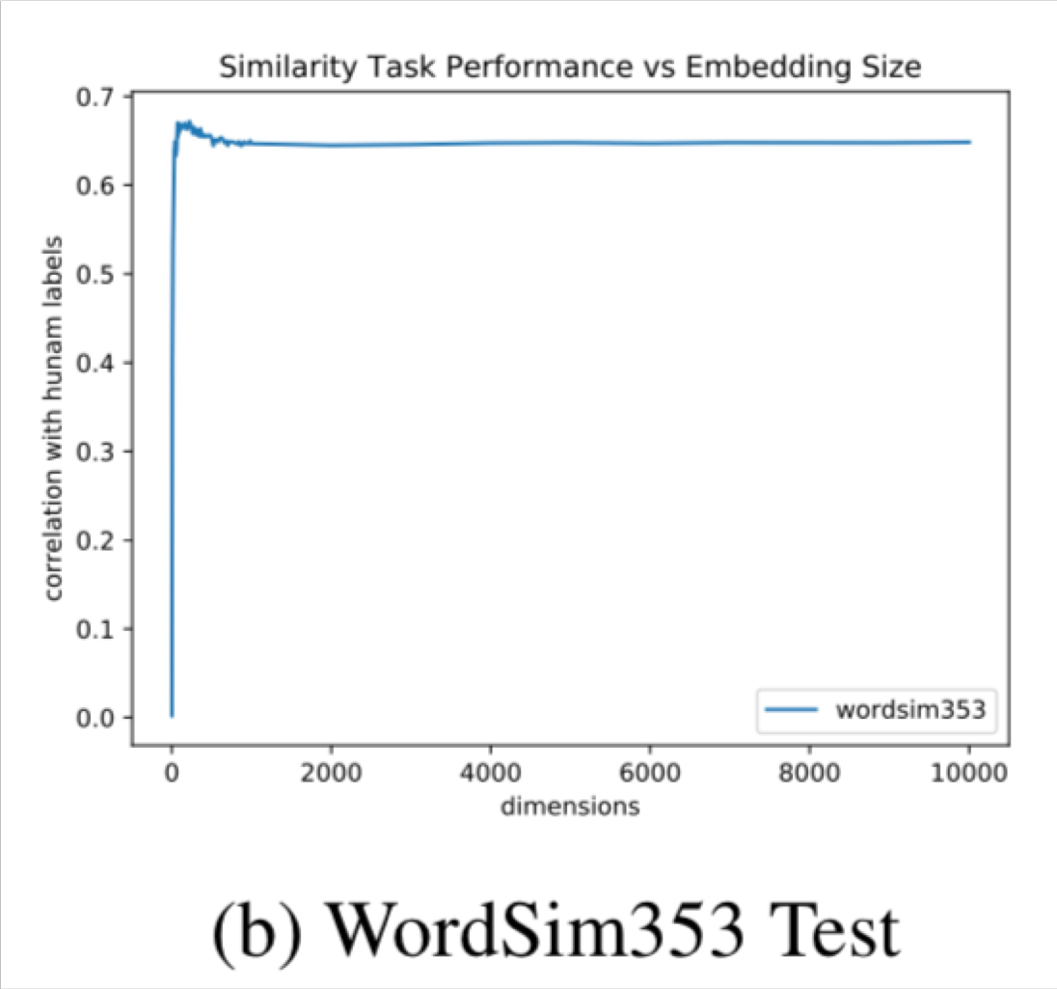
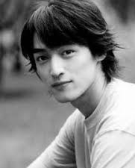

On the Dimensionality of Word Embedding
[Zi Yin and Yuanyuan Shen, NeurIPS 2018]
https://papers.nips.cc/paper/7368-on-the-dimensionality-of-word-embedding.pdf
Using matrix perturbation theory, reveal a fundamental bias- variance trade-off in dimensionality selection for word embeddings
41

Slide 42
Analogy evaluation and hyperparameters
More training time helps
Training Time (hrs)
9 12 15
3
6
18
21
24
72
70
68
66
Accuracy [%]
64
GloVe Skip-Gram
62
60
20
40 60
Iterations (GloVe)
80
100
1 2 3 4 5 6 7 10 12 15
Negative Samples (Skip-Gram)
20

Slide 43












Analogy evaluation and hyperparameters
More data helps, Wikipedia is better than news text!
Semantic
Syntactic
Overall
85
80
75
70
65
60
55
50
Accuracy [%]
Wiki2010 1B tokens
Wiki2014 1.6B tokens
Gigaword5 4.3B tokens
Gigaword5 + Wiki2014 6B tokens
Common Crawl 42B tokens

Slide 44
Another intrinsic word vector evaluation
Word vector distances and their correlation with human judgments
Example dataset: WordSim353 http://www.cs.technion.ac.il/~gabr/resources/data/wordsim353/
Word 1 | Word 2 | Human (mean)
tiger | cat | 7.35
tiger | tiger | 10
book | paper | 7.46
computer | internet | 7.58
plane | car | 5.77
professor | doctor | 6.62
stock | phone | 1.62
stock | CD | 1.31
stock | jaguar | 0.92

Slide 45
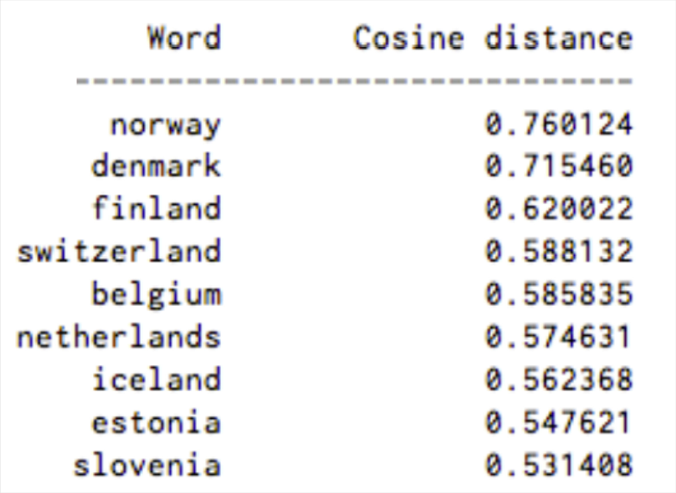
Closest words to “Sweden” (cosine similarity)

Slide 46
Correlation evaluation
Word vector distances and their correlation with human judgments
Model | Size | WS353 | MC | RG | SCWS | RW
SVD | 6B | 35.3 | 35.1 | 42.5 | 38.3 | 25.6
SVD-S | 6B | 56.5 | 71.5 | 71.0 | 53.6 | 34.7
SVD-L | 6B | 65.7 | 72.7 | 75.1 | 56.5 | 37.0
CBOW† | 6B | 57.2 | 65.6 | 68.2 | 57.0 | 32.5
SG† | 6B | 62.8 | 65.2 | 69.7 | 58.1 | 37.2
GloVe | 6B | 65.8 | 72.7 | 77.8 | 53.9 | 38.1
SVD-L | 42B | 74.0 | 76.4 | 74.1 | 58.3 | 39.9
GloVe | 42B | 75.9 | 83.6 | 82.9 | 59.6 | 47.8
CBOW⇤ 100B |  | 68.4 | 79.6 | 75.4 | 59.4 | 45.5
Some ideas from Glove paper have been shown to improve skip-gram (SG) model also (e.g. sum both vectors)

Slide 47
Word senses and word sense ambiguity
Most words have lots of meanings!
  Especially common words
  Especially words that have existed for a long time
Example: pike
Does one vector capture all these meanings or do we have a mess?

Slide 48
pike
A sharp point or staff
A type of elongated fish
A railroad line or system
A type of road
The future (coming down the pike)
A type of body position (as in diving)
To kill or pierce with a pike
To make one’s way (pike along)
In Australian English, pike means to pull out from doing something: I reckon he could have climbed that cliff, but he piked!

Slide 49
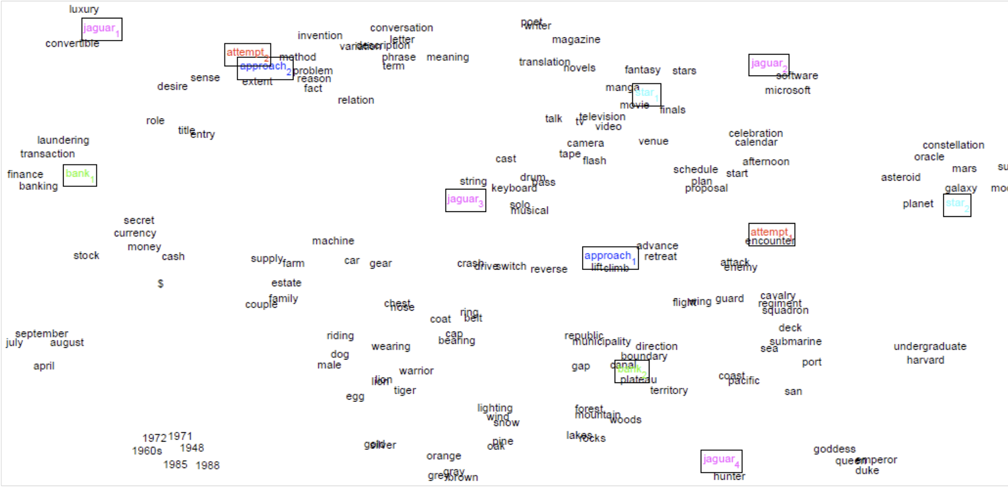
Improving Word Representations Via Global Context And Multiple Word Prototypes (Huang et al. 2012)
Idea: Cluster word windows around words, retrain with each word assigned to multiple different clusters bank₁, bank₂, etc

Slide 50
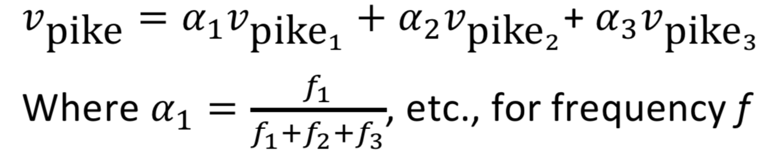
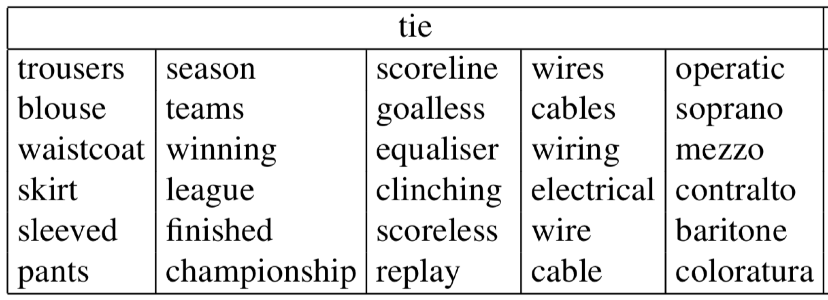
Linear Algebraic Structure of Word Senses, with
Applications to Polysemy
(Arora, …, Ma, …, TACL 2018)
Different senses of a word reside in a linear superposition (weighted sum) in standard word embeddings like word2vec
•
^{𝑣}pike ^{= 𝛼}(^{𝑣}pike₎ ^{+ 𝛼}+^{𝑣}pike₂ ^{+ 𝛼}3^{𝑣}pike₃
Where 𝛼₍ =
Surprising result:
  Because of ideas from sparse coding you can actually separate out the senses (providing they are relatively common)

Slide 51
Extrinsic word vector evaluation
Extrinsic evaluation of word vectors: All subsequent tasks in this class
One example where good word vectors should help directly: named entity recognition: finding a person, organization or location
Model | Dev | Test | ACE | MUC7
Discrete | 91.0 | 85.4 | 77.4 | 73.4
SVD | 90.8 | 85.7 | 77.3 | 73.7
SVD-S | 91.0 | 85.5 | 77.6 | 74.3
SVD-L | 90.5 | 84.8 | 73.6 | 71.5
HPCA | 92.6 | 88.7 | 81.7 | 80.7
HSMN | 90.5 | 85.7 | 78.7 | 74.7
CW | 92.2 | 87.4 | 81.7 | 80.2
CBOW | 93.1 | 88.2 | 82.2 | 81.1
GloVe | 93.2 | 88.3 | 82.9 | 82.2
Next: How to use word vectors in neural net models!

Slide 52
Course plan: coming weeks
Week 2: Neural Net Fundamentals
We concentrate on understanding (deep, multi-layer) neural networks and how they can be trained (learned from data) using backpropagation (the judicious application of calculus)
We’ll look at an NLP classifier that adds context by taking in windows around a word and classifies the center word (not just representing it across all windows)!
Week 3: We learn some natural language processing
We learn about putting syntactic structure (dependency parses) over sentence (this is HW3!)
We develop the notion of the probability of a sentence (a probabilistic language model) and why it is really useful

Slide 53

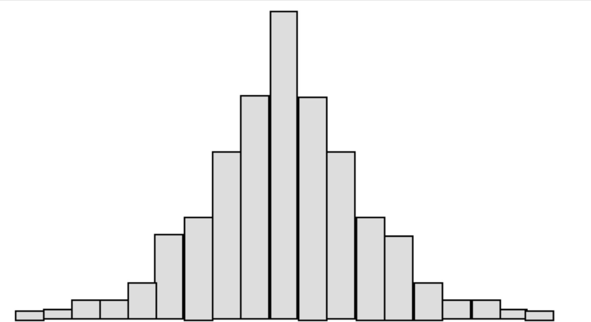
A note on your experience !
“Terrible class” “Don’t take it”
“Instructors don’t care” “Too much work”
“Best class at Stanford” “Changed my life”
“Obvious that instructors care” “Learned a ton”
“Hard but worth it”
This is a hard, advanced, graduate level class
I and all the TAs really care about your success in this class
Give Feedback. Take responsibility for holes in your knowledge
Come to office hours/help sessions
53

Slide 54
Office Hours / Help sessions
Come to office hours/help sessions!
  Come to discuss final project ideas as well as the homeworks
  Try to come early, often and off-cycle
Help sessions: daily, at various times, see calendar
  First one is tonight: 6:30–9:00pm
  Gates Basement B21 (and B30) – bring your student ID
  Attending in person: Just show up! Our friendly course staff will be on hand to assist you
  SCPD/remote access: Use queuestatus
Chris’s office hours:
  Mon 1–3pm. Come along this Monday?
54

